Slide 1
ME 141
Engineering Mechanics
Portion 4
Analysis of Structure
Partha Kumar Das
Lecturer
Department of Mechanical Engineering, BUET
http://teacher.buet.ac.bd/parthakdas/

Slide 2
Frame
Truss
Machine
Structures
TRUSS:
Consists of Two Force Members
Designed to Support Load
Fully Constrained
FRAME:
Consists of at least one Multi-force Member
Designed to Support Load
Fully Constrained
MACHINE:
Consists of at least one Multi-force Member and Moving Parts
Designed to Transmit or Modify Forces
Fully Constrained

Slide 3
Structural Analysis
A Structure: Frame
Free Body Diagram of the Structure
Free Body Diagram of Individual Parts
BE: Two Force Member

Slide 4
Structure: Truss
Ikitsuki Bridge

Slide 5
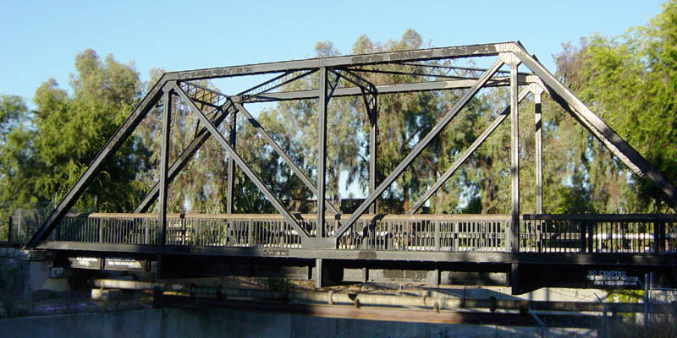
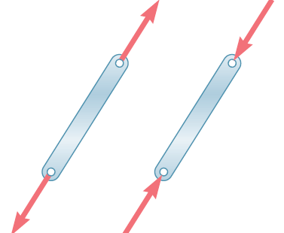
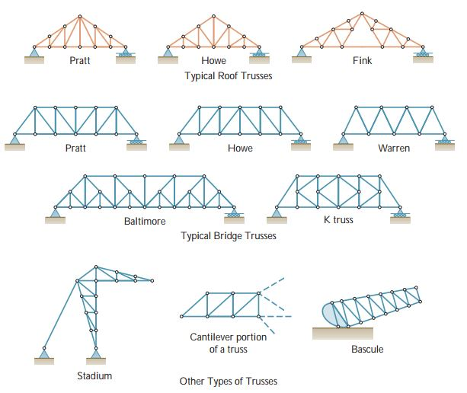
Truss
All the members are connected through pin joint to each other.

Slide 6
Truss
Method of Joint
Truss Analysis
Method of Section

Slide 7
Truss Analysis: Joint Method
Truss can be considered as group of two force members and multi-force pins.
Free Body Diagram of entire structure
Free Body Diagram of each member and pin

Slide 8
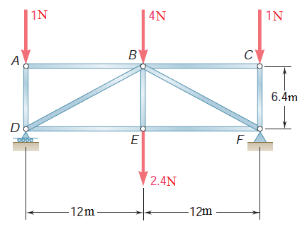
Problem 4.1 (Beer Johnston_10th edition_P6.5)
Using the method of joints, determine the force in each member of the truss shown. State whether each member is in tension or compression.

Slide 9
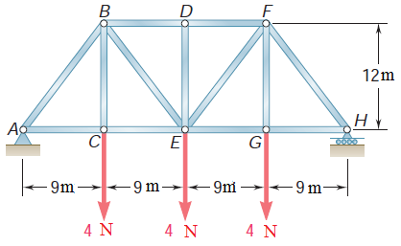
Problem 4.2 (Beer Johnston_10th edition_P6.21)
Using the method of joints, determine the force in each member of the Pratt bridge truss shown. State whether each member is in tension or compression.
ANS.: F AB = 7.5 N (C), F AC = 4.5 N (T) F CE = 4.5 N (T), F BC = 4.0 N (T) F BE = 2.5 N (T), F BD = 6.0 N (C)
F AB = 0 (Zero Force Member), F DF = 6.0 N (C) Due to Symmetry, FEF = 2.5 N (T), FEG = 4.5 N (T), FFG =4.0 N (T), FFH = 7.5 N (C), FGH = 4.5 N (T)

Slide 10
Truss Analysis: Section Method
To find the force of a particular member in truss, section method is suitable.
A section should be chosen in such a way that cut not more than three members.
Eliminate the cut members and draw the free body diagram of any of the two divided sides.

Slide 11
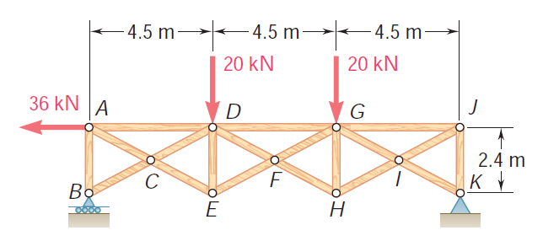
Problem 4.3 (Beer Johnston_10th edition_P6.49)
Determine the force in members AD, CD, and CE of the truss shown.
ANS.: F AD = 13.5 kN (C),
F CD = 0, F CE = 56.1 kN (T)

Slide 12
Problem 4.4 (Beer Johnston_10th edition_P6.61 and 6.62)
Determine the force in members EH, GI, HJ and IL of the truss shown.
ANS.: F EH = 22.5 N (C), F GI = 22.5 N (T),
F HJ = 33.8 N (C), F IL = 33.8 N (T)

Slide 13
Frame Analysis
Draw the free body diagram of the individual members.
Apply three equilibrium conditions to any multiforce members
Draw the free body diagram of the entire truss
Consists of at least one multiforce member
A Structure: Frame
Free Body Diagram of the Structure
Free Body Diagram of Individual Parts
BE: Two Force Member

Slide 14
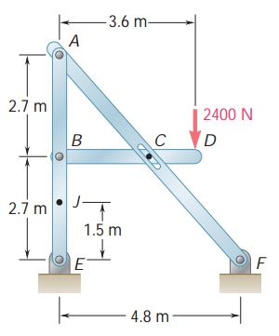
Problem 4.5 (Beer Johnston_10th edition_P6.100)
For the frame and loading shown, determine the components of all forces acting on member ABE.
ANS.: B = 4224 N 16.5° E = 2112.02 N 106.5°
A = 2079 N 48.4°

Slide 15
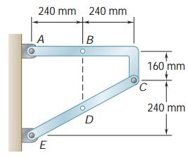
Problem 4.6 (Beer Johnston_10th edition_P6.84)
Determine the components of the reactions at A and E if the frame is loaded by a clockwise couple of magnitude 36 N.m applied at B.

Slide 16
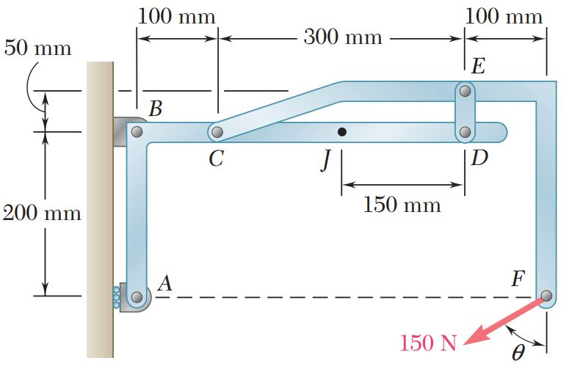
Problem 4.7 (Beer Johnston_10th edition_P6.82)
Determine the components of all forces acting on member ABCD when θ = 90°.
ANS.: A = 150 N→, B = 0, Cx = 150N←, Cy = 100 N↑, D = 100 N↓

Slide 17
End of Portion 4

Slide 18
References
Vector Mechanics for Engineers: Statics and Dynamics
Ferdinand Beer, Jr., E. Russell Johnston, David Mazurek, Phillip Cornwell.

